Slide 1
Welcome to Mendelian Randomization
Three basic principles for performing MR analysis
How to write a MR paper systematically
Some tips needing special attention

Slide 2


Professor George Davey Smith
Professor of Clinical Epidemiology, Bristol University
Stephen Burgess
Cardiovascular Epidemiology, Cambridge University

Slide 3
Some links and R packages for learning mendelian randomization
http://www.mendelianrandomization.com/index.php
http://www.mrbase.org/
http://www.ukbiobank.ac.uk/tag/mendelian-randomization/
1. MendelianRandomization
2. TwoSampleMR
3. MRPRESSO

Slide 4
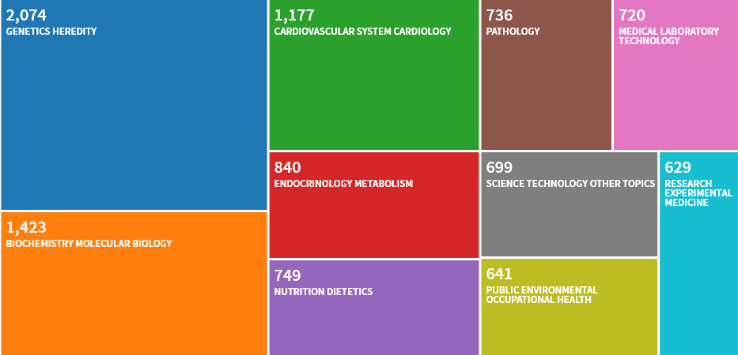

Slide 5
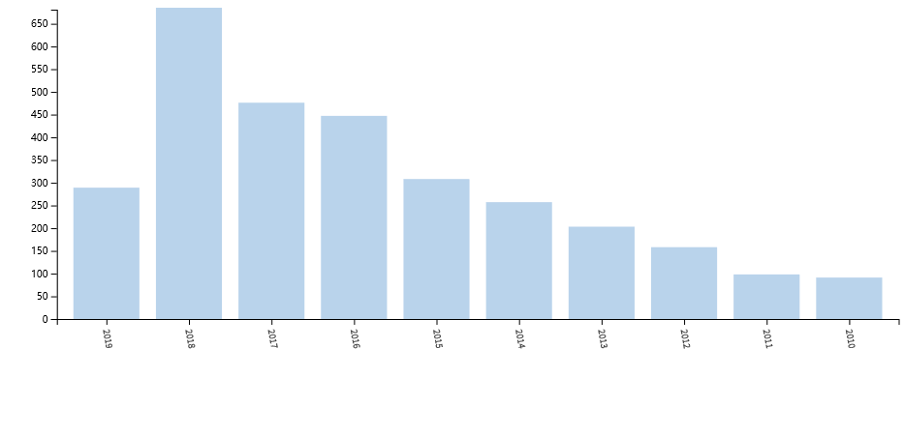

Slide 6
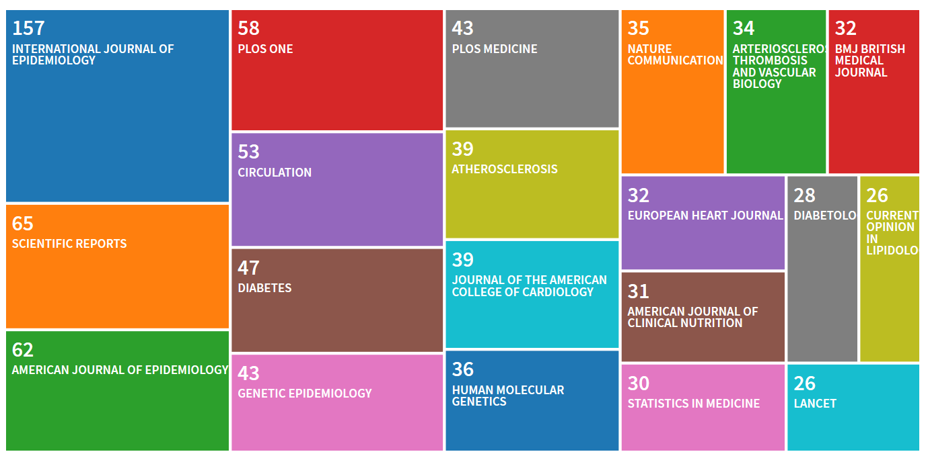

Slide 7
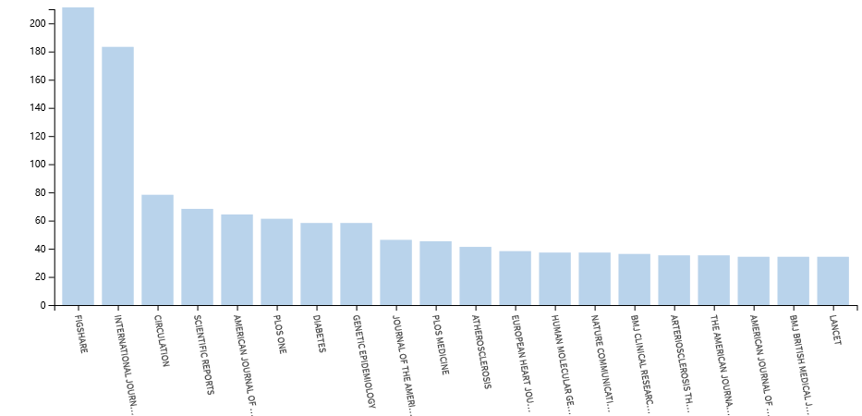

Slide 8
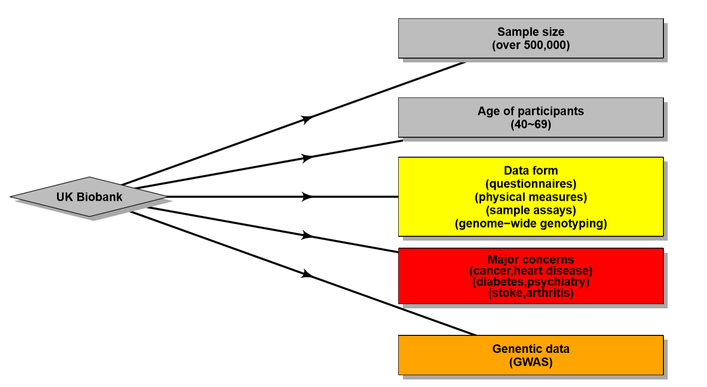
A brief introduction to our MR data source —— UKBB

Slide 9
The data coding of daytime napping in UK Biobank
Phenotype（ID） | Encode | Description | Sample_size
sleep duration(1160) | hours/day | There are 23 distinct values; Mean = 7.15655 | 501,656
chronotype(1180) | 1 | Definitely a 'morning' person | 132606
 | 2 | More a 'morning' than 'evening' person | 173927
 | 3 | More an 'evening' than a 'morning' person | 138371
 | 4 | Definitely an 'evening' person | 44238
 | -1 | Do not know | 56888
 | -3 | Prefer not to answer | 1579
nap(1190) | 1 | Never/rarely | 309451
 | 2 | Sometimes | 211151
 | 3 | Usually | 29761
 | -3 | Prefer not to answer | 1019
insomnia(1200) | 1 | Never/rarely | 132192
 | 2 | Sometimes | 262133
 | 3 | Usually | 156413
 | -3 | Prefer not to answer | 644

Slide 10
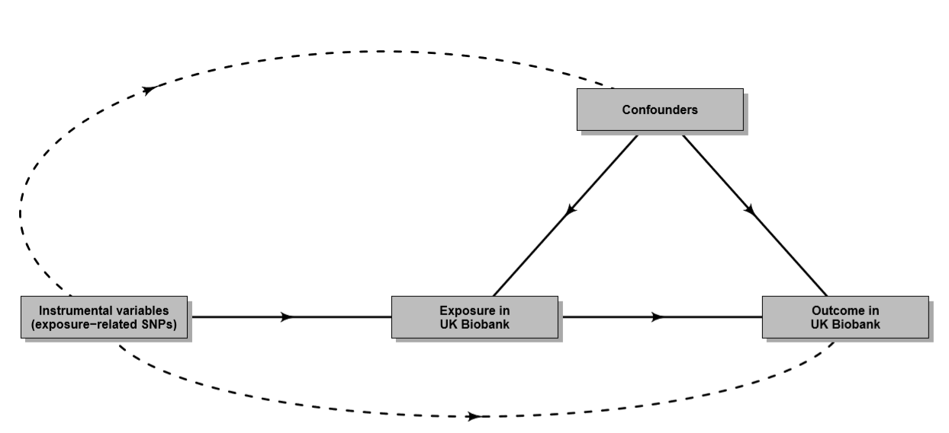
Three basic principles for Mendelian Randomization

Slide 11
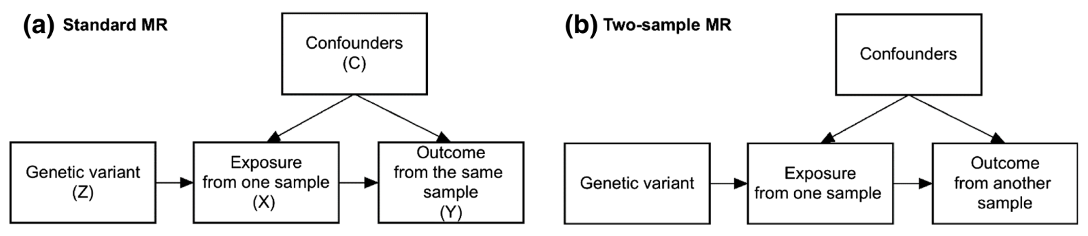
What’s the difference between Standard MR and Two-sample MR ?

Slide 12
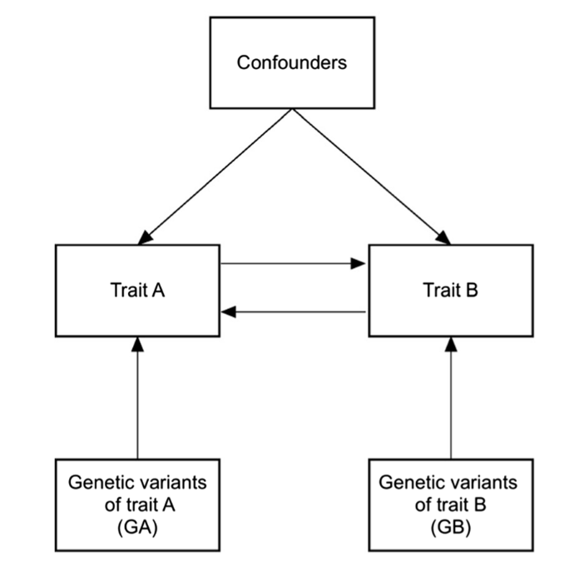
Bidirectional MR

Slide 13
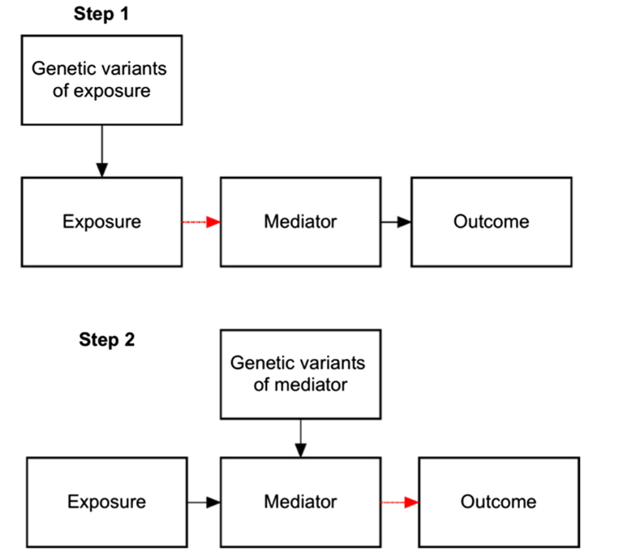
Two Step MR

Slide 14
There are some other MR methods focusing on different aspects of MR, such as multivariable MR and factorial MR, about which you can find some academic research papers in PubMed. Please note that all MR methods should abide by the three basic principles mentioned above.

Slide 15
How to write a MR paper systematically ?
Introduction: To clarify the existing problems in your concerned fields and propose the concept and advantages of MR
Methods: To describe your data source and basic MR principles. In addition, a brief explanation to statistical methods is welcomed
Results: To depict the atlas of your results (focused on results of interest)
Conclusion: To discuss the potential mechanism hidden in your discovery

Slide 16
How to write an introduction?
Firstly, you should point out the recent progress in your research field and the lack of validated causal links
Secondly, there are usually some research papers in conflict with each other. Please describe them and reveal it that why such contradictory phenomenon happens
Finally, it is time to propose your MR methods and its advantages of solving the problems you mentioned above

Slide 17
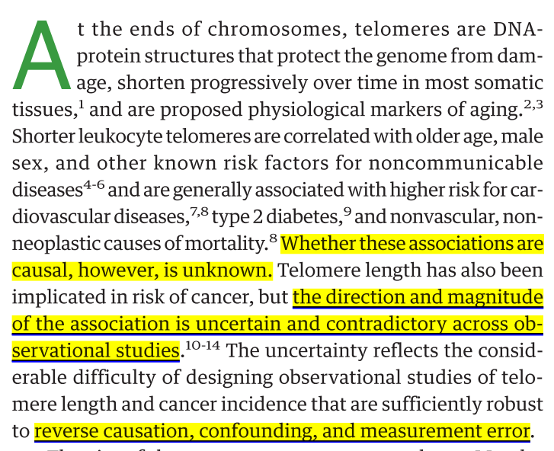
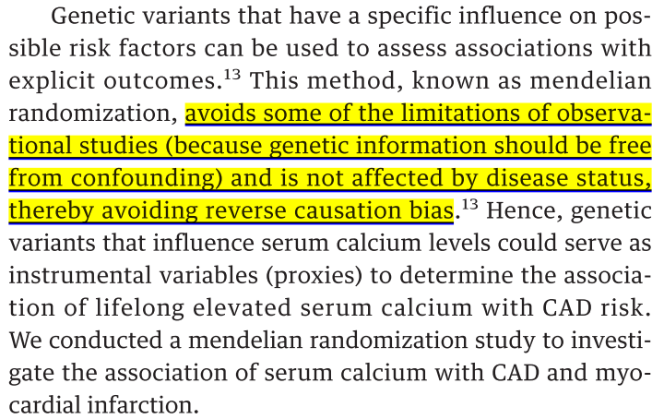
1. Haycock PC, Burgess S, Nounu A, Zheng J, Okoli GN, et al. 2017. Association Between Telomere Length and Risk of Cancer and Non-Neoplastic Diseases: A Mendelian Randomization Study. JAMA Oncol 3:636-51
1. Larsson SC, Burgess S, Michaelsson K. 2017. Association of Genetic Variants Related to Serum Calcium Levels With Coronary Artery Disease and Myocardial Infarction. Jama 318:371-80

Slide 18
How to write a MR method?
Usually, you may see a MR paper involving a lot of consortiums in it but our only data source is UK Biobank. Of course, you can include other consortiums in your study as you like.
Please describe your data source
Introduce the three basic principles lying in MR
Depict our high throughput method of processing UK Biobank data
Finally, please explain our statistical methods

Slide 19
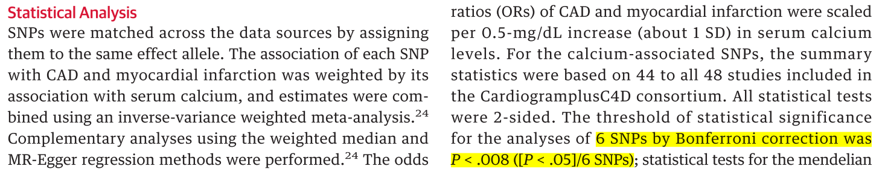
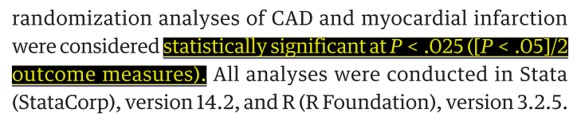

Slide 20
How to explicitly express our discovery with correctness?
Describe the SNP information you have selected as instrumental variables
Give the pleiotropy test result
Depict the MR analysis results and we have to focus on both β (to determine the causal direction) and P value (to give statistical significance)
It is better off analyzing our high throughput result in phenotype sets. Here I denote that the phenotype set is a group of phenotypes sharing similar traits such as sleep-related traits and urine-associated traits.

Slide 21
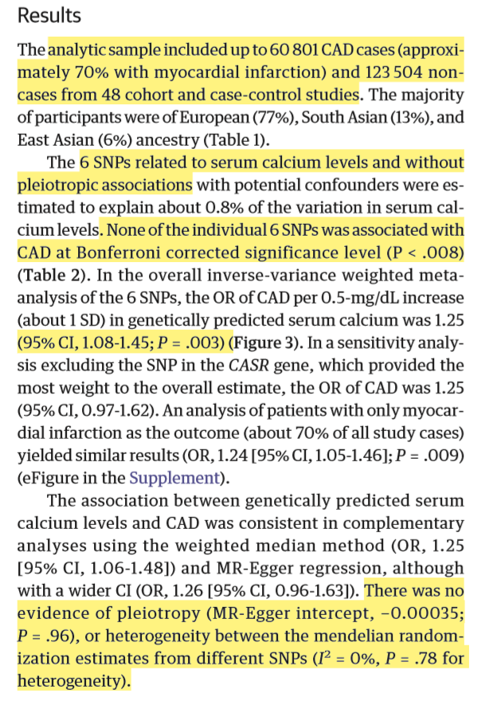
It is the MR result of a MR paper published in JAMA.
Please pay attention the aspects of MR results narrated in it

Slide 22
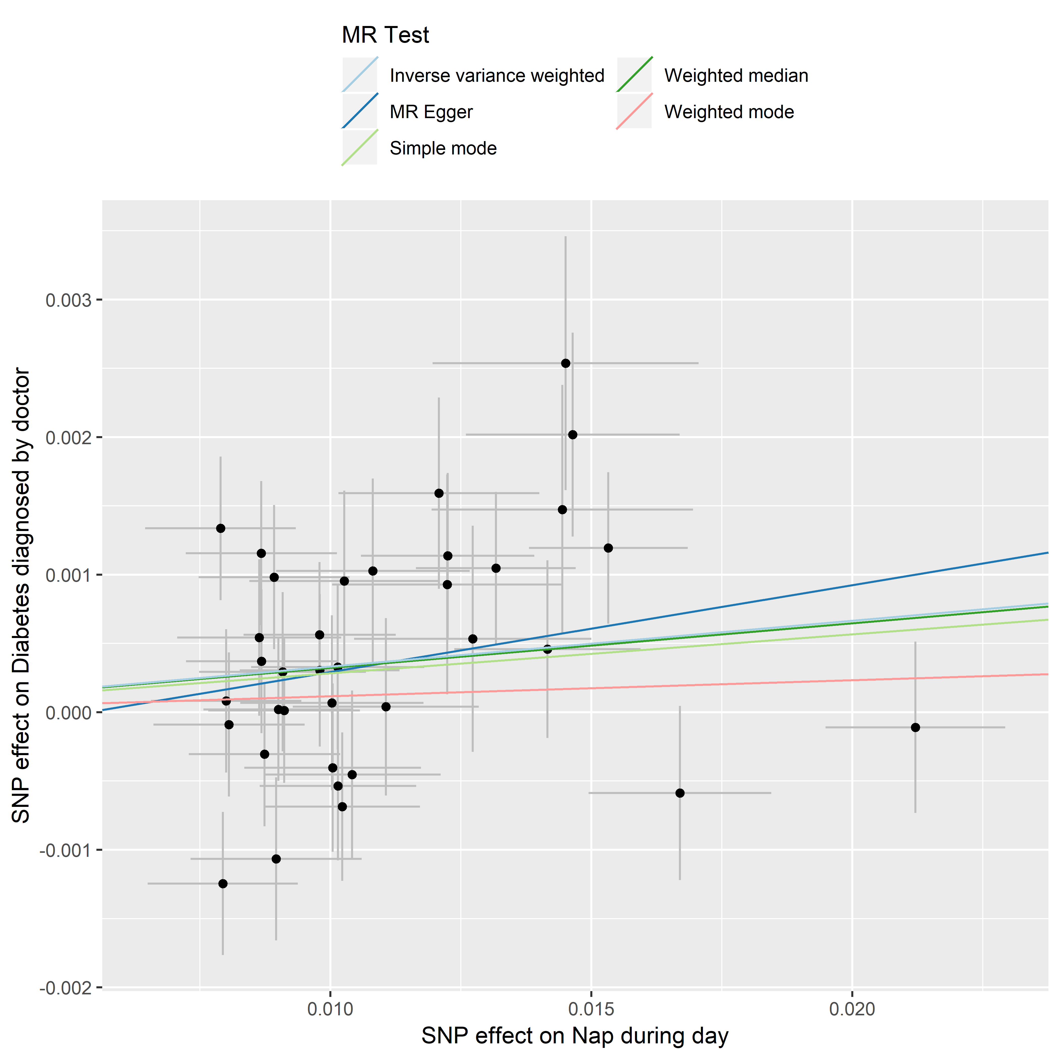
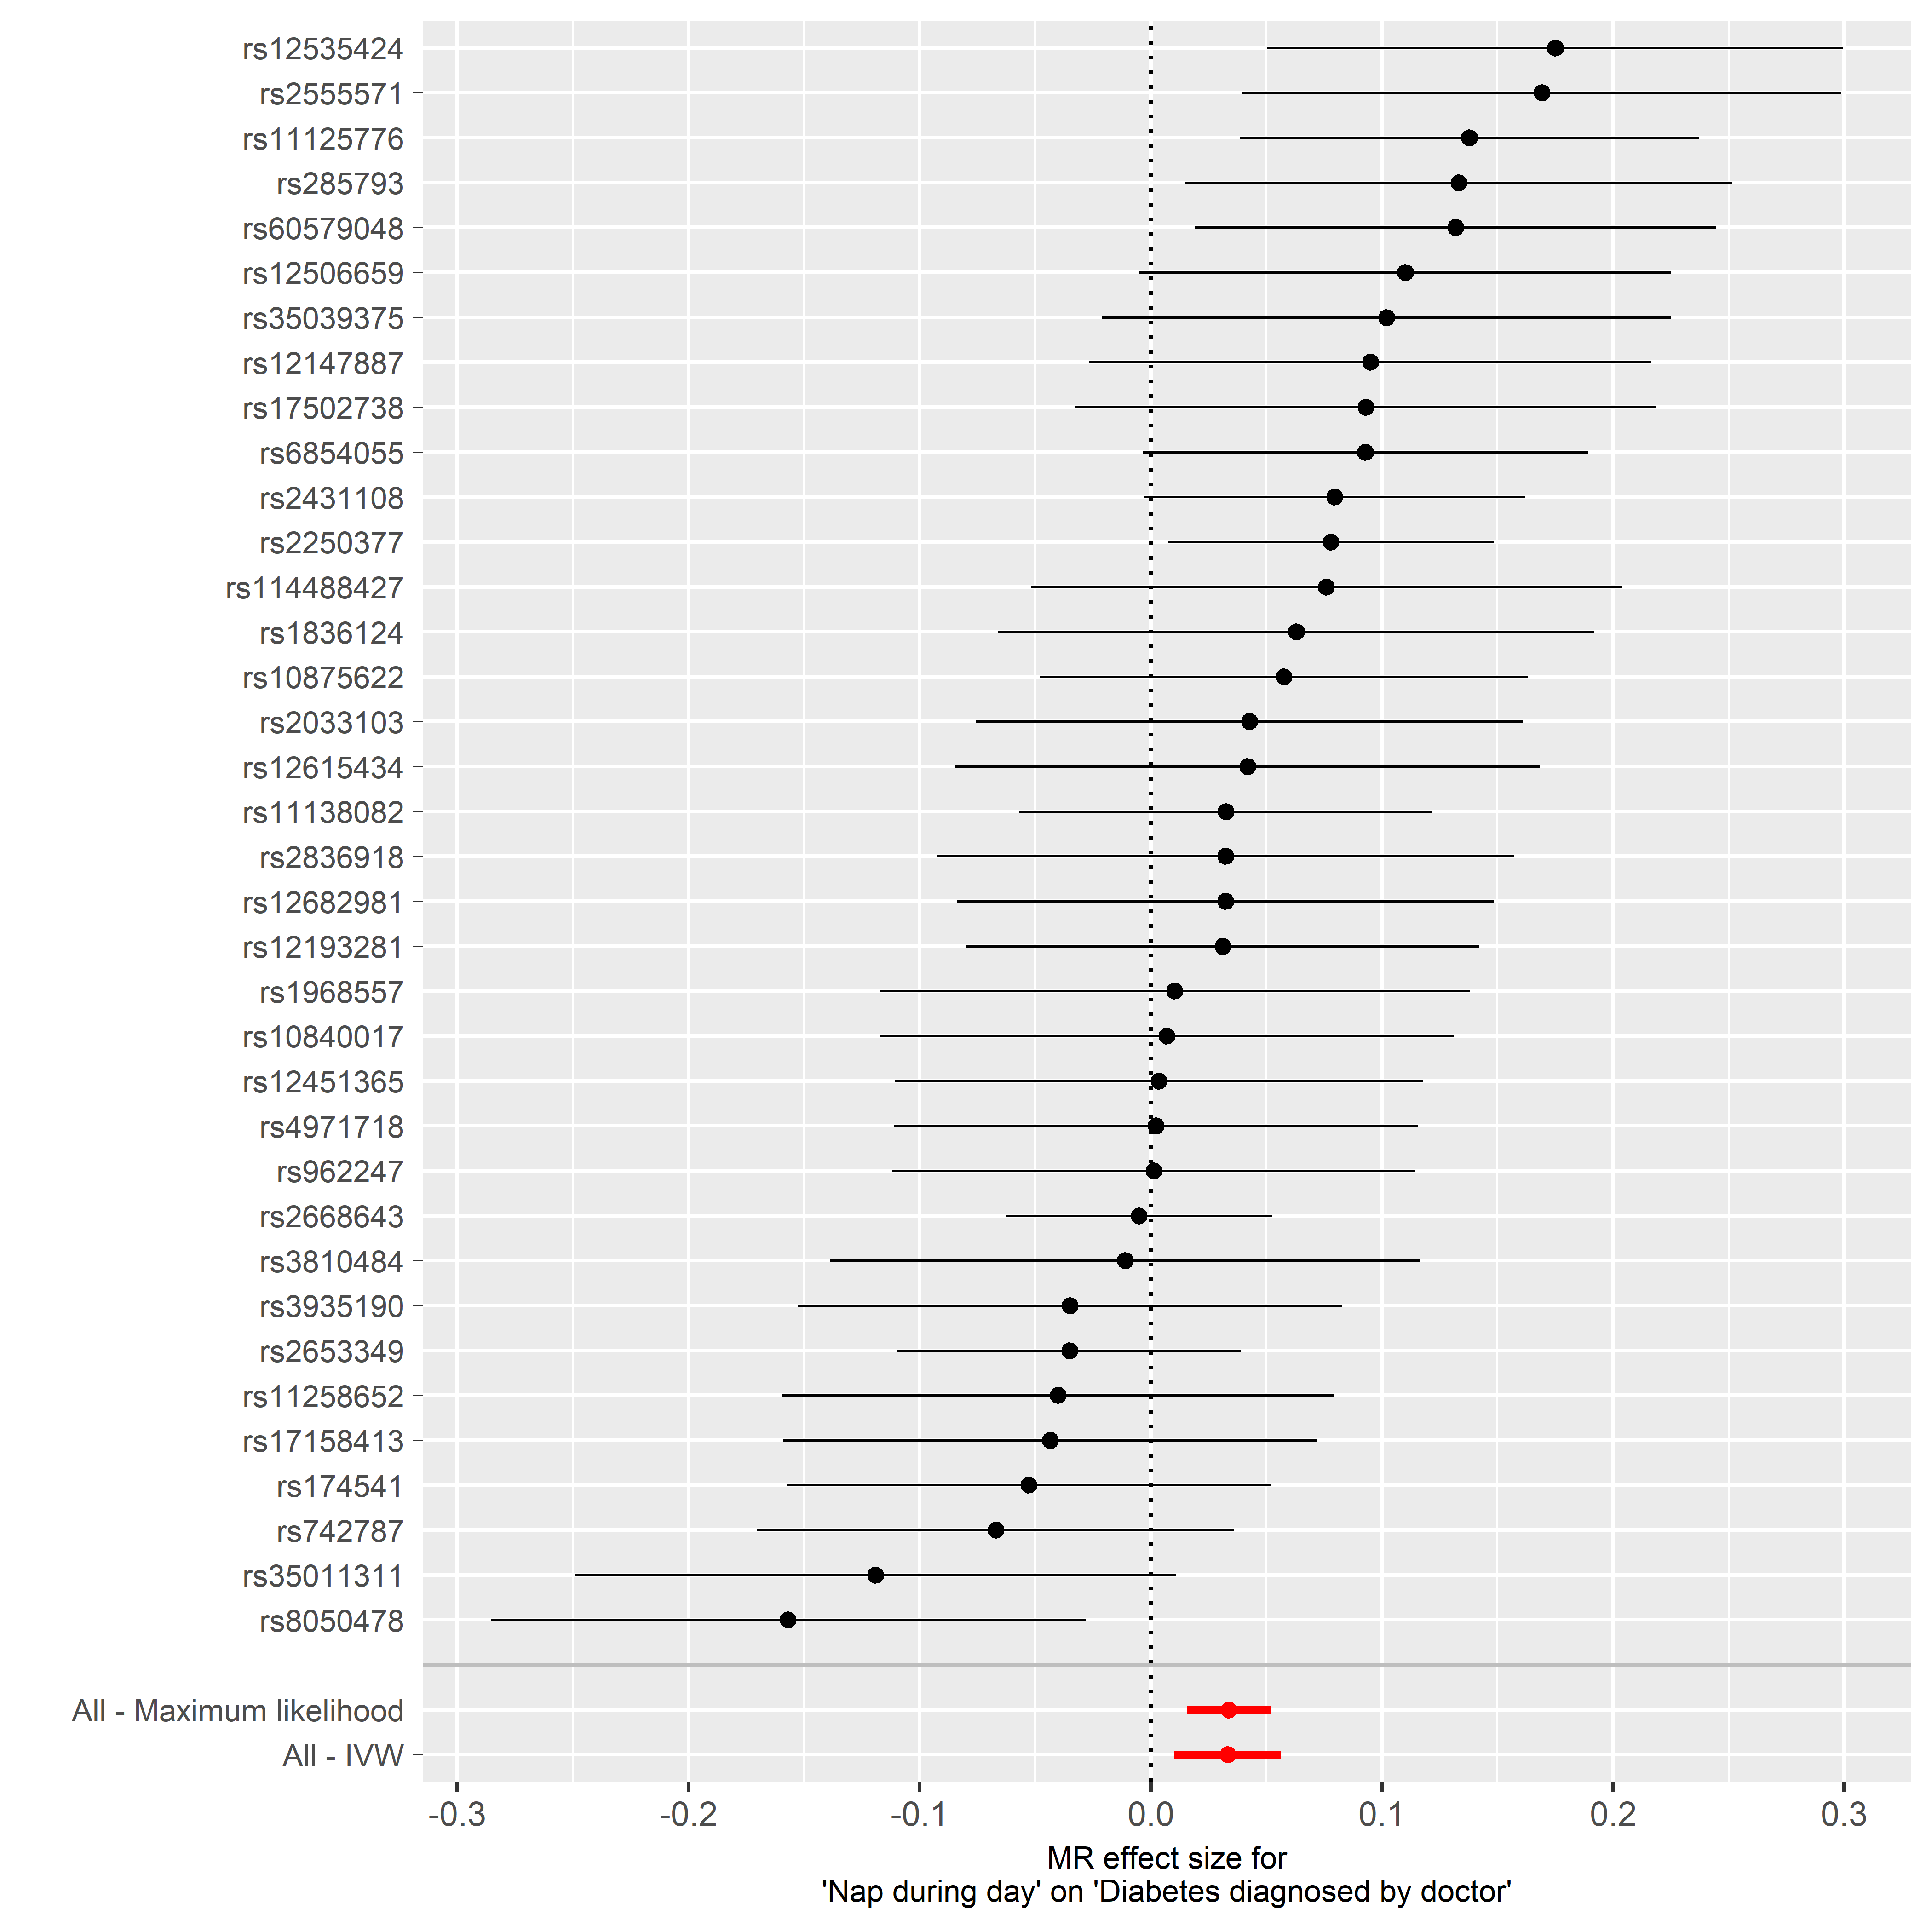
Scatter plot and forest plot of MR results

Slide 23
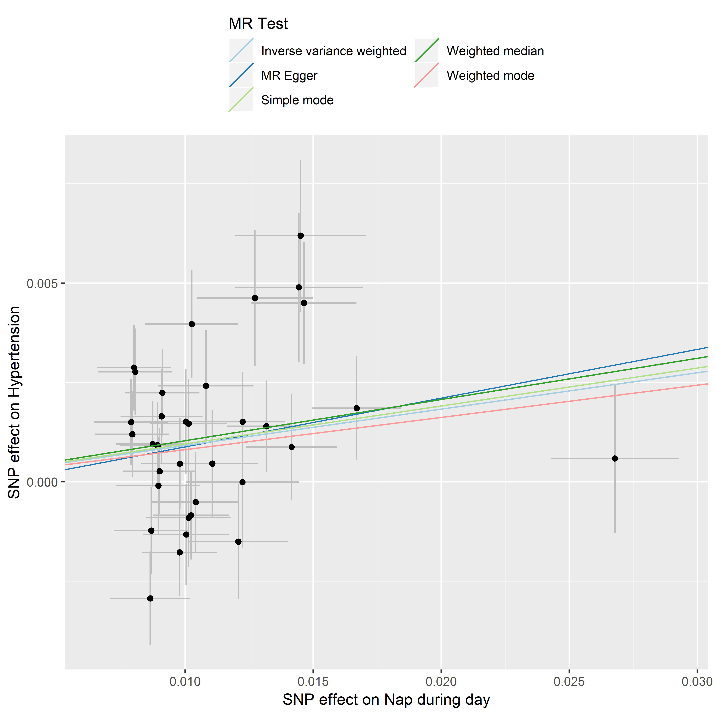
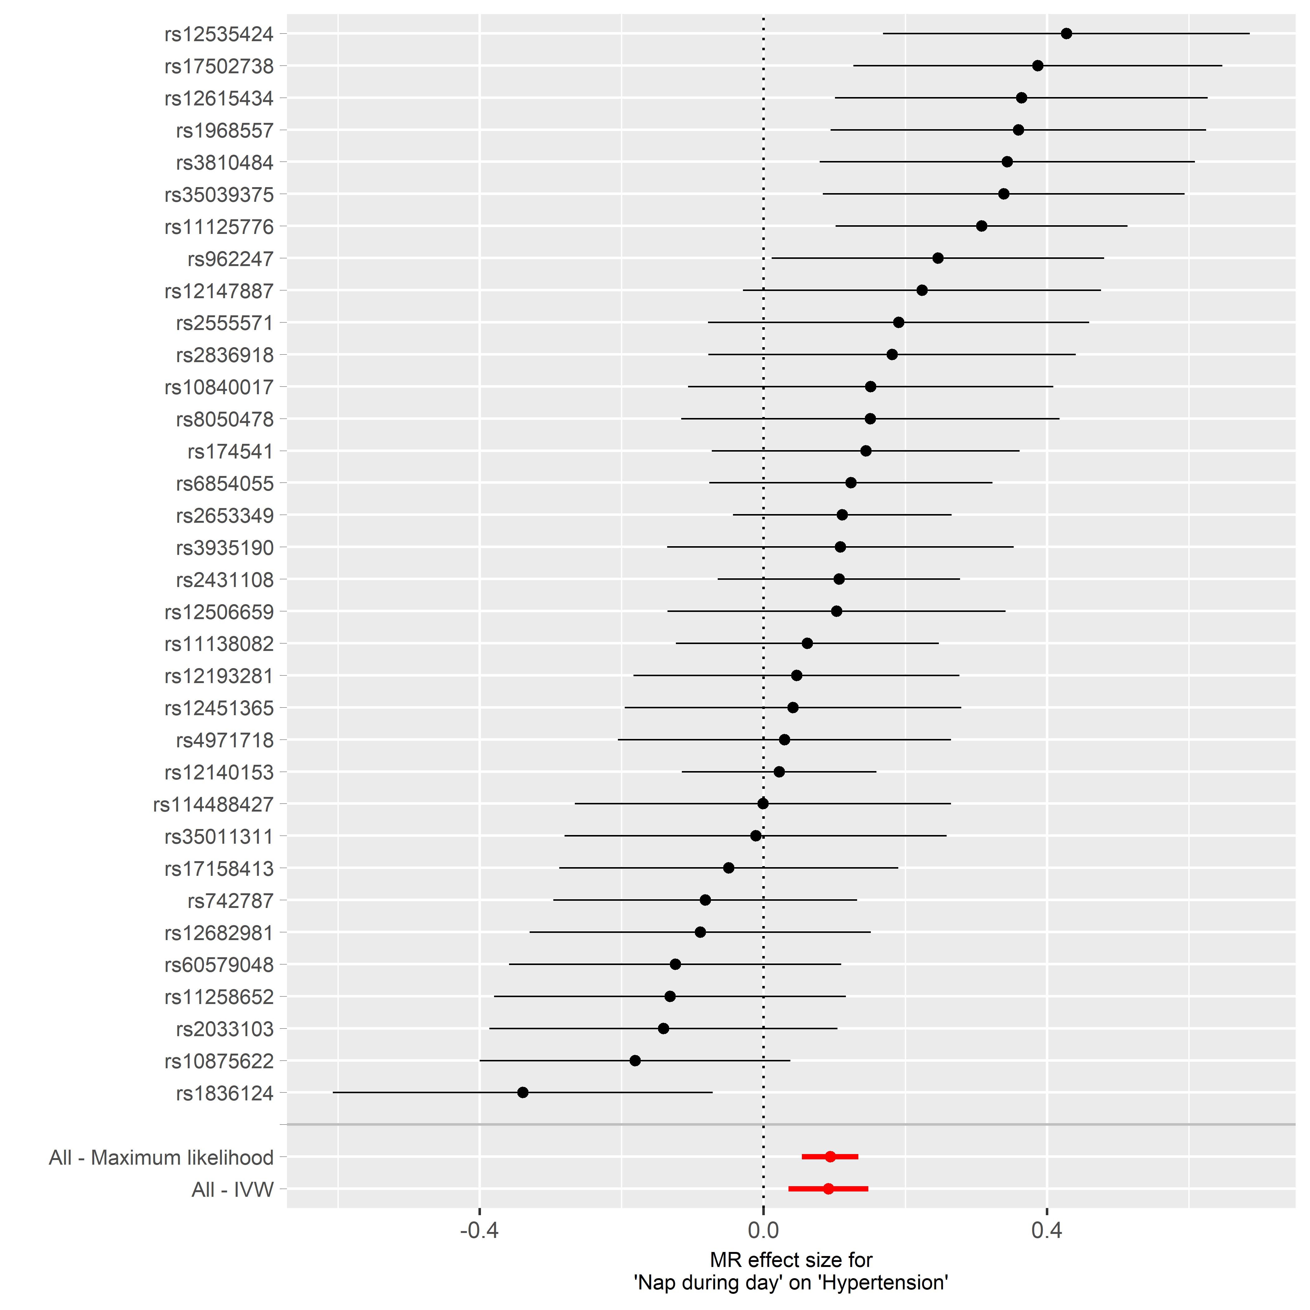

Slide 24
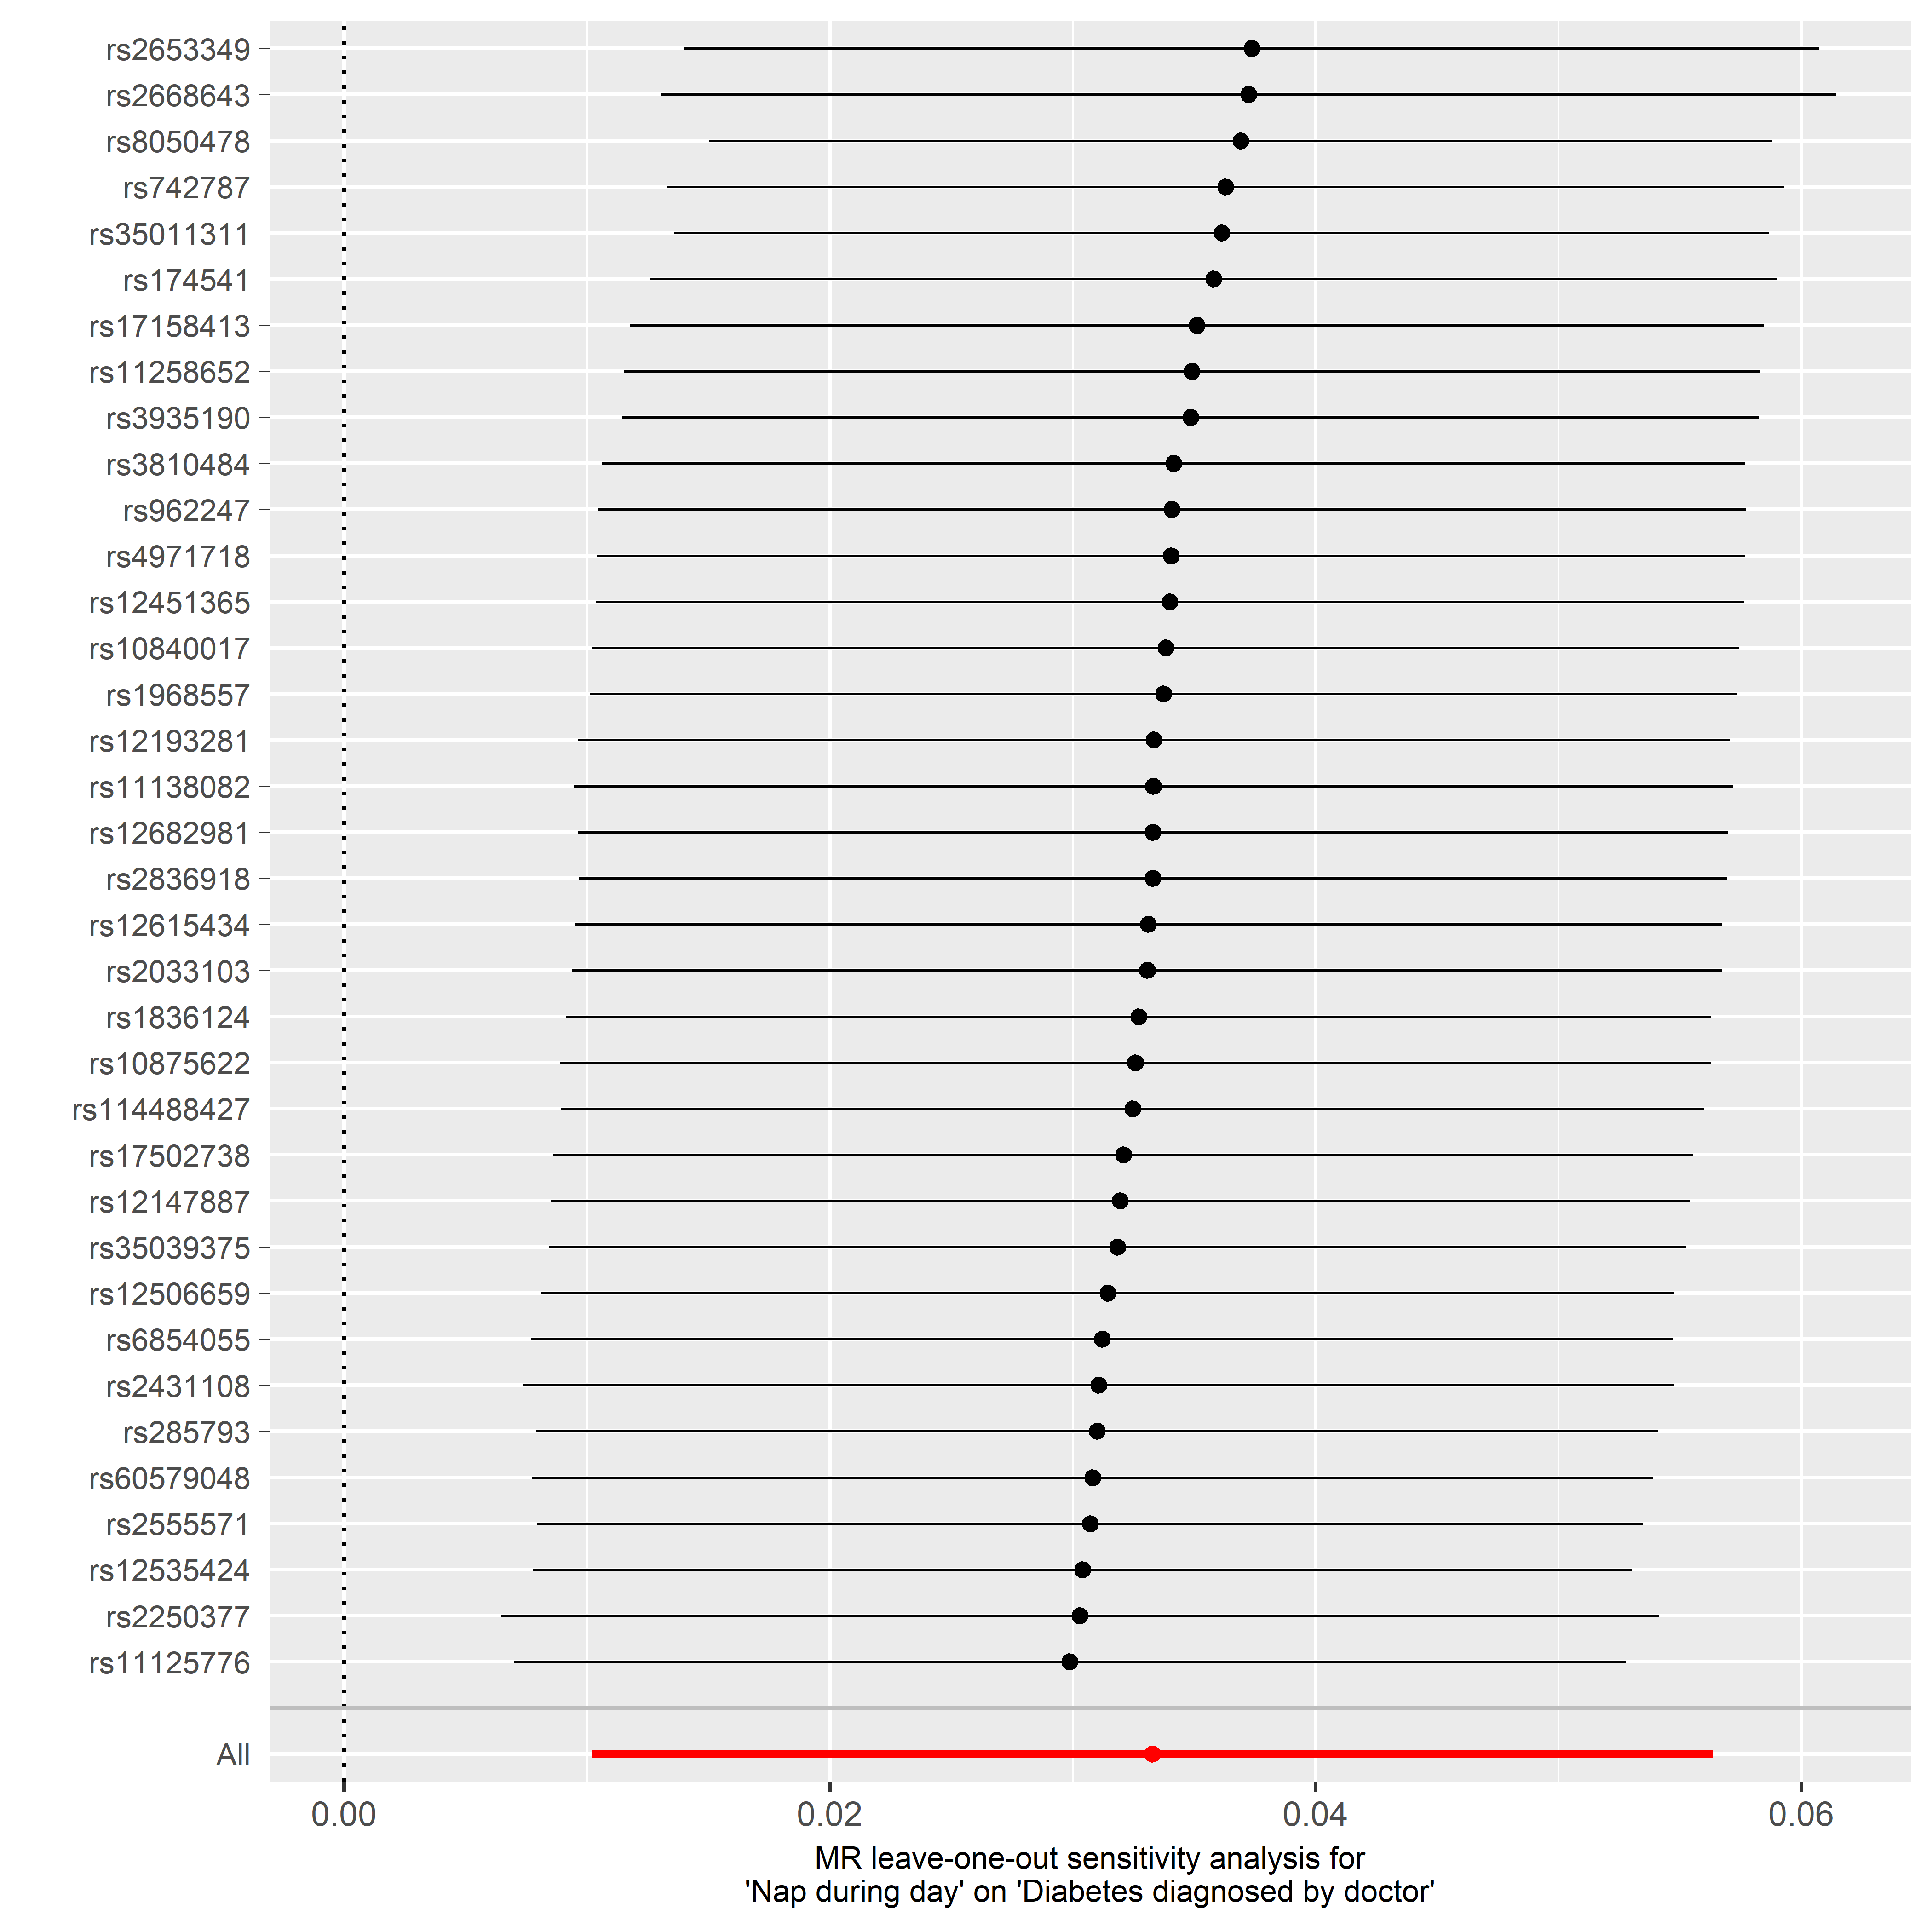
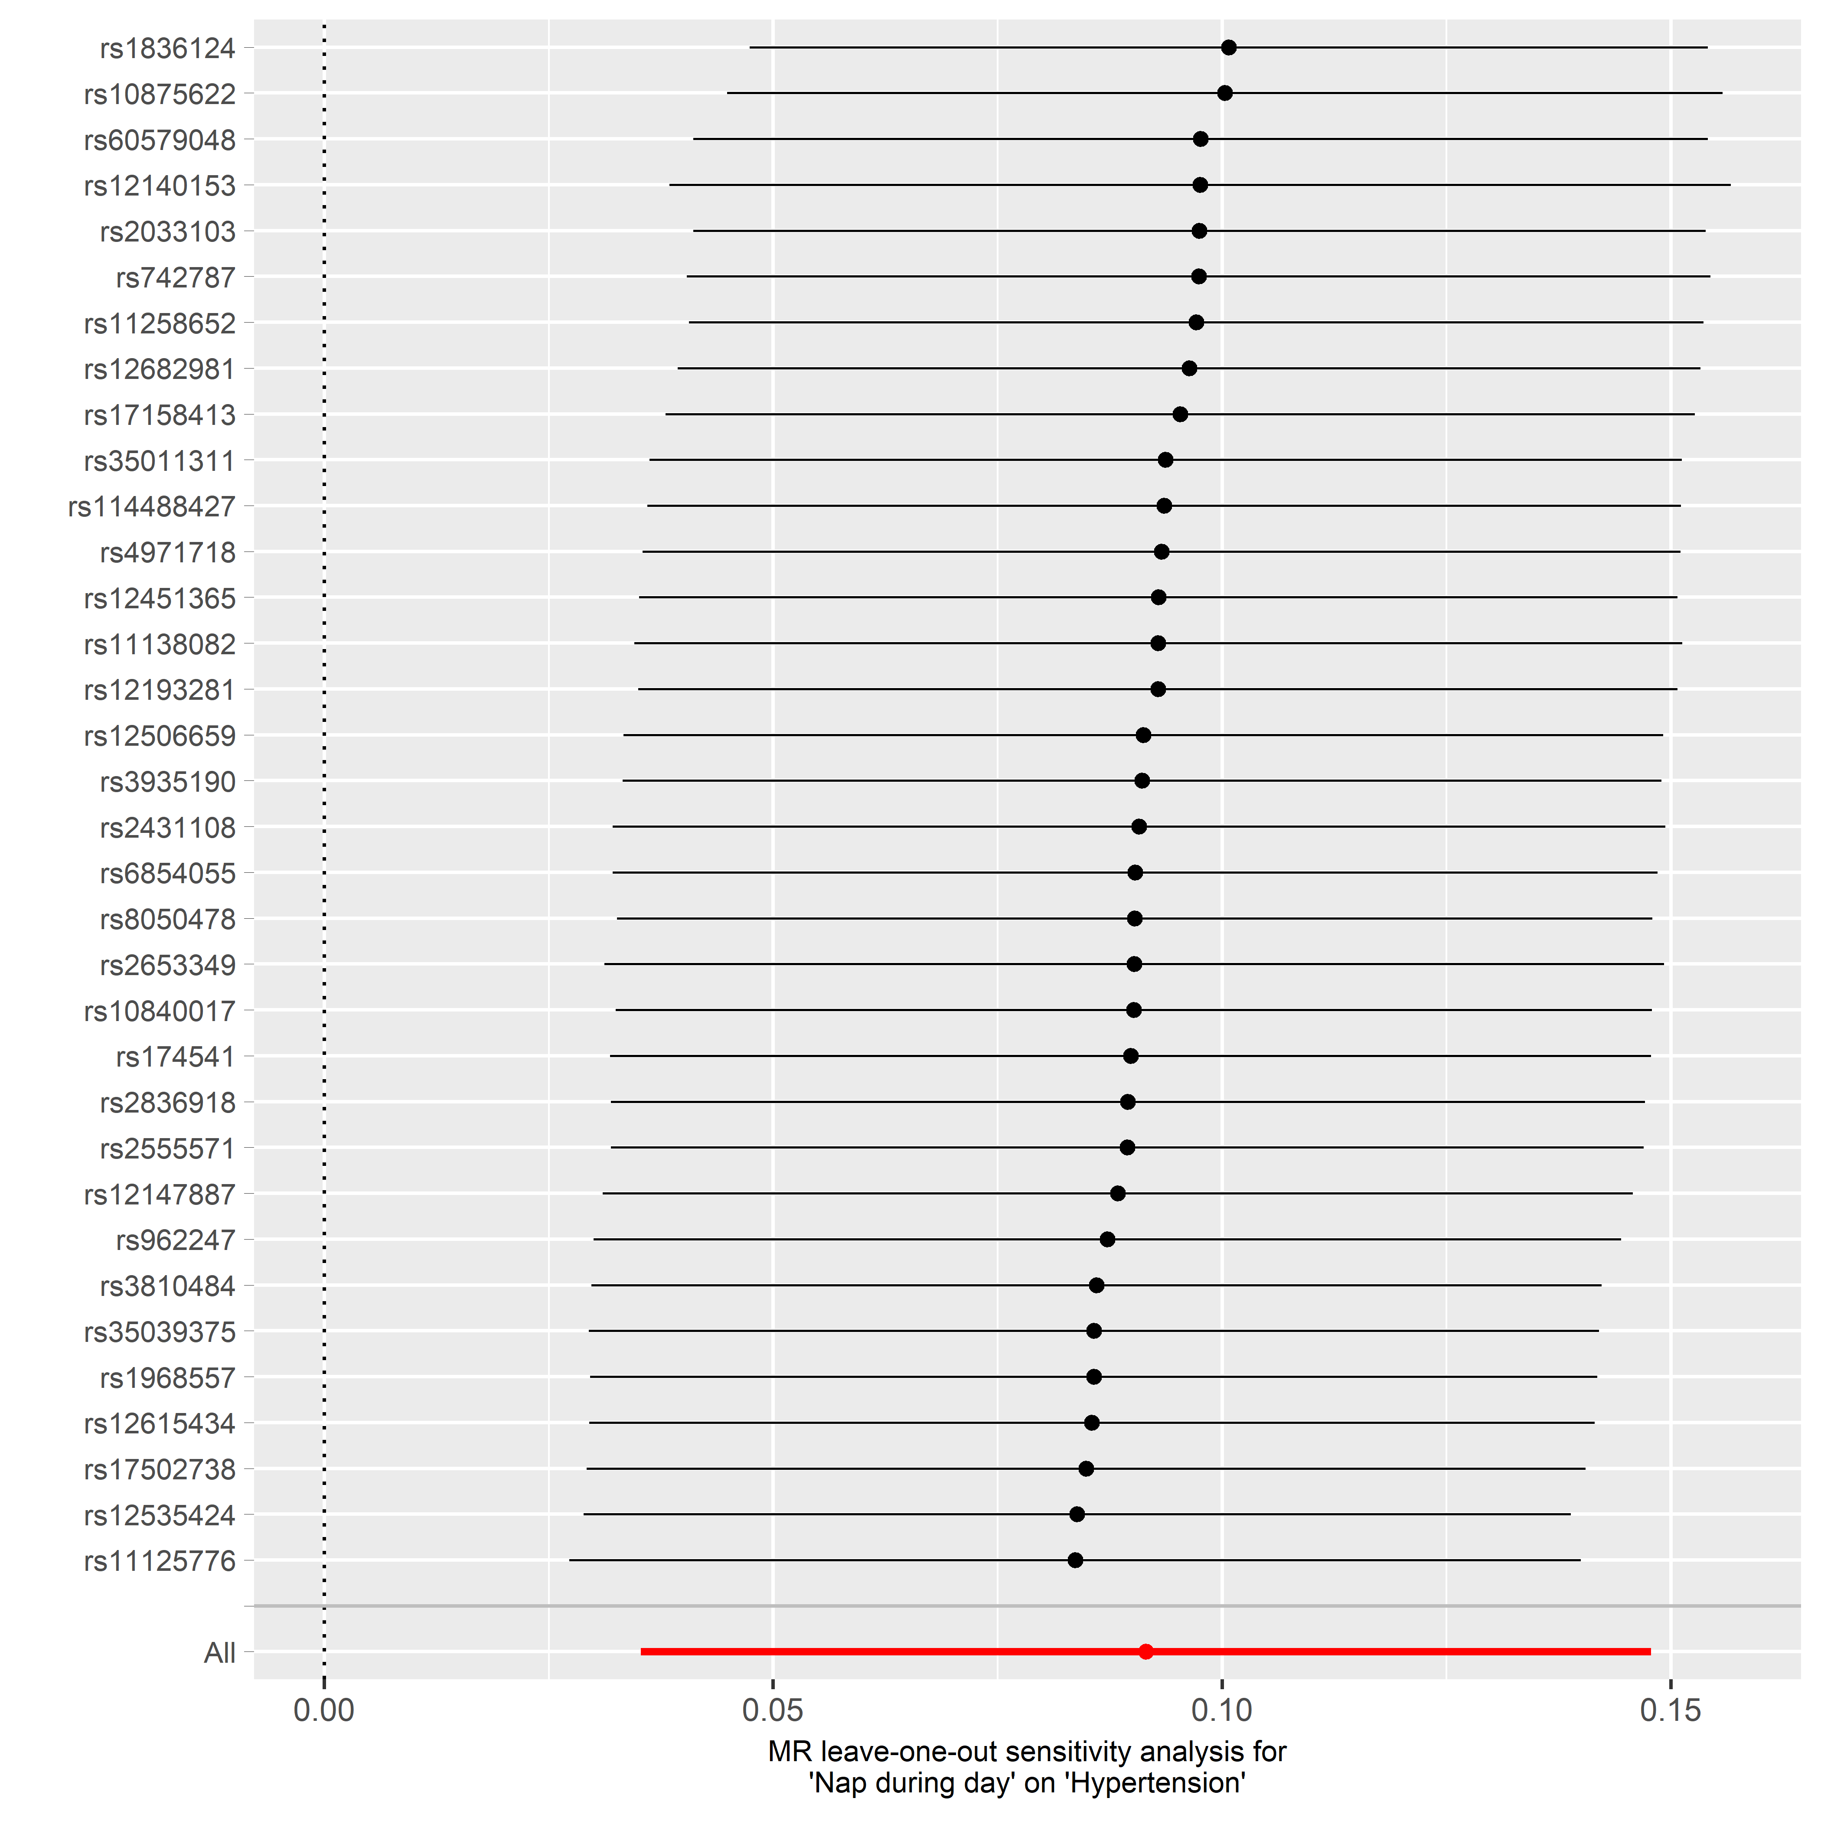
Leave-one-out sensitivity analysis of MR results

Slide 25
How to improve our discussion part?
Please give a short summary of your discovery
It is preferred to explore the potential mechanism lying in you discovery
Add whatever you think is novel and appropriate to your discovery
Please highlight the actual application and significance of your discovery

Slide 26
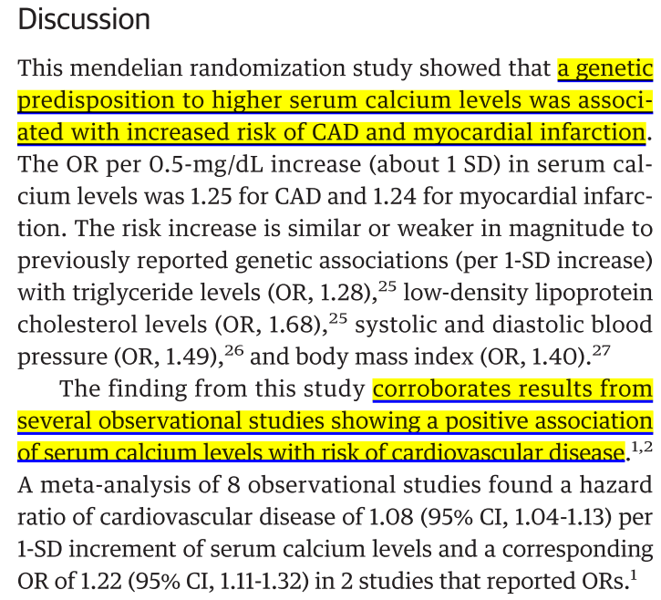

Slide 27
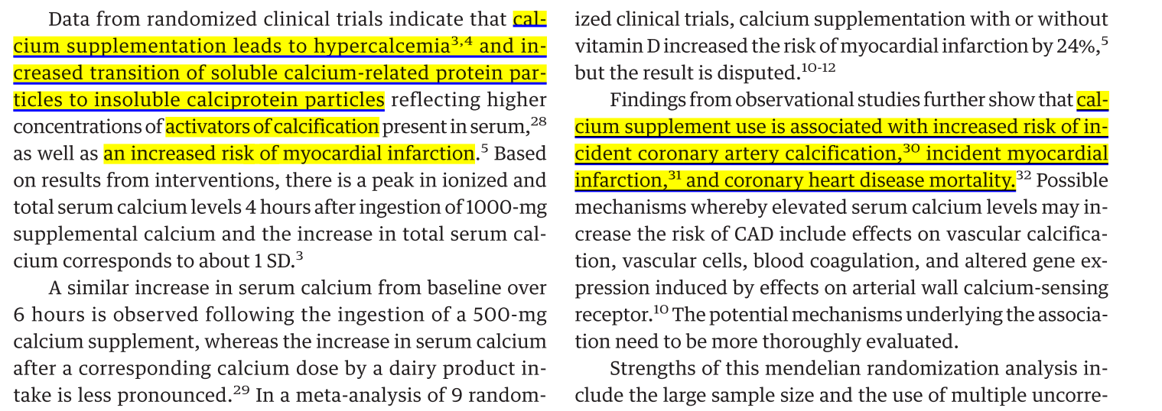

Slide 28
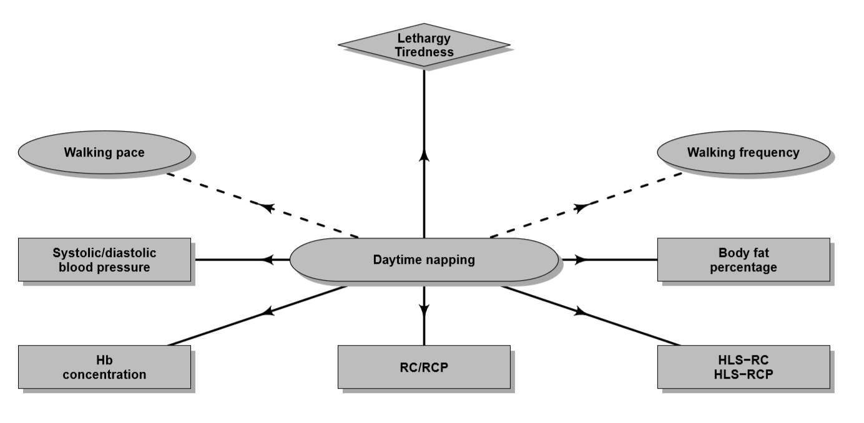

Slide 29
Tips needing special attention
Our major challenge in performing MR analysis is how to eliminate the pleiotropy.
Here I will introduce some applicable methods for solving the problem.
Restrict the P value between SNPs and outcome < 0.05
If you would like to lower the threshold of P value above in order to include more SNPs, PRESSO is better for assessing pleiotropy.
You can locate your SNP to its corresponding gene and a pathway analysis may indicate its potential pleiotropy.
Of course, you can use all three methods mentioned above but it may elevate the false negative rate
So, it needs special consideration and you can do appropriate adjustment in writing your own paper.

Slide 30
Finally, I will take my own unpublished paper as an example to write MR scientifically.
Please be generous with your sincere suggestion and criticism.

Slide 31
Thank you for your listening!
Muchas Gracias

